Slide 1
Transitioning to Object Oriented Programing

Slide 2
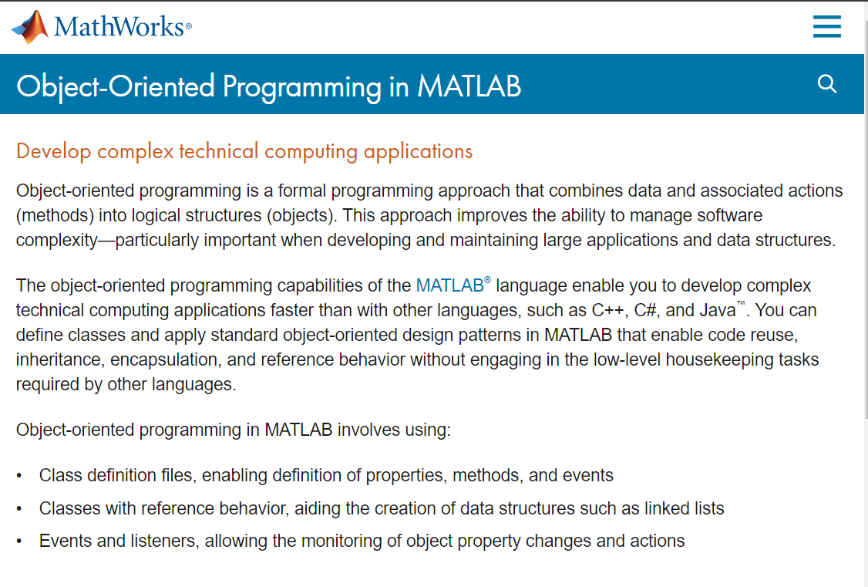
Transitioning to Object Oriented Programing

Slide 3
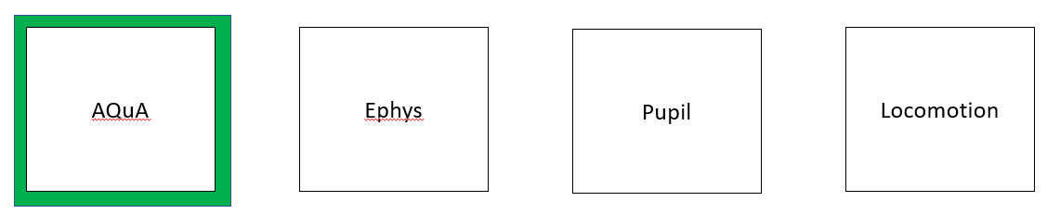
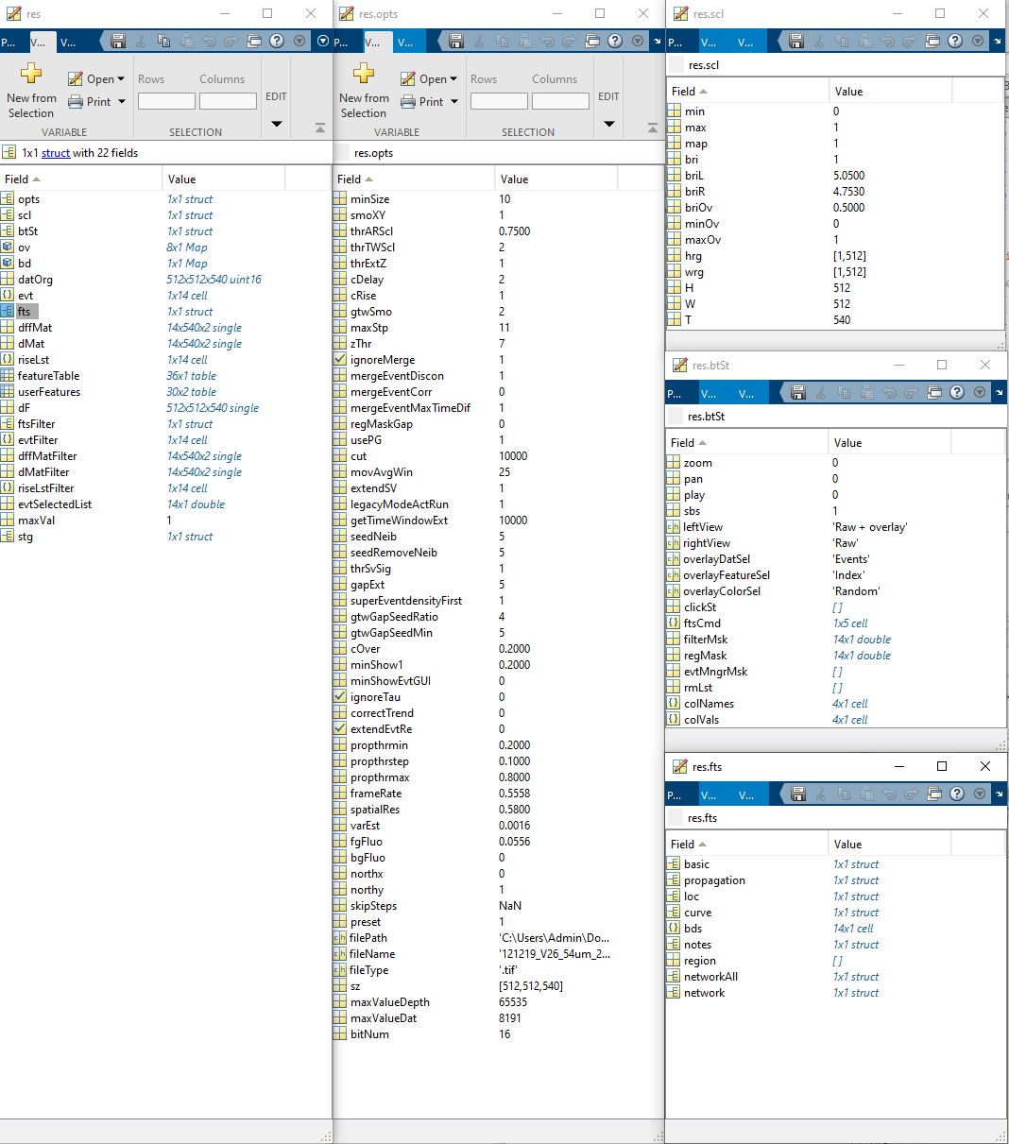
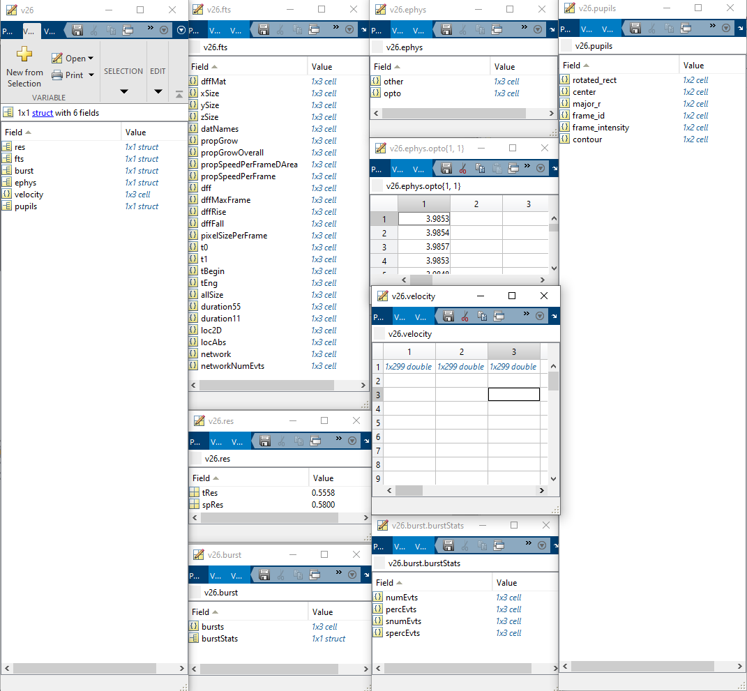
Extracting salient information
T = ~35s
Preprocess
Functions:
readFts
readEphys
readPupil
detectBursts
detectSparkles
opto2velocity
…
One trial:
Data structure is >700 MB
Three trials
Data structure is ~3 MB

Slide 4
Transitioning to Object Oriented Programing
Scripts
Data
Parameters

Slide 5
Transitioning to Object Oriented Programing
Scripts
Data
Parameters
Contain many ‘functions’
Often copy/pasted for each new trial / experiment
Often large and cumbersome
After preprocessing, often stored separately from analysis and plotting functions
Can change between experiments
Need to be linked permanently to the analyzed dataset

Slide 6
Transitioning to Object Oriented Programing
Scripts
Data
Parameters
Master Scripts
Analysis Results
Figures and Plots

Slide 7
Scripts
Data
Parameters
Transitioning to Object Oriented Programing
Functions
(i/o)
Reusable Class Object
Analysis Results
Figures and Plots

Slide 8
Scripts
Data
Parameters
Transitioning to Object Oriented Programing
Functions
(i/o)
Reusable Class Object
Analysis Results
Figures and Plots

Slide 9
Transitioning to Object Oriented Programing
Scripts
Data
Parameters
Every function has one ‘job’ (i.e. opto2velocity)
This make it much easier to troubleshoot issues and debug because each task is isolated
This keeps things consistent between experiments and promotes reusability
As long as you keep the input and output the same you can continue to build on the function without affecting downstream processing
Functions
(i/o)
Reusable Class Object
Analysis Results
Figures and Plots

Slide 10
Transitioning to Object Oriented Programing
Scripts
Data
Parameters
Functions
(i/o)
Reusable Class Object
Analysis Results
Figures and Plots

Slide 11
Transitioning to Object Oriented Programing
Scripts
Data
Parameters
Importantly, this class can be used repeatedly for all similar experiments.
You make a single class object through making an instance of the class. This is done by passing it the current experiments parameters (data directory, temporal and spatial resolution of the videos, etc.)
This class object can be saved and reloaded later easily
Functions
(i/o)
Reusable Class Object
Analysis Results
Figures and Plots

Slide 12
Transitioning to Object Oriented Programing
Abstraction: The process of picking out (abstracting) common features of objects and procedures.
Class: A category of objects. The class defines all the common properties of the different objects that belong to it.
Encapsulation: The process of combining elements to create a new entity. A procedure is a type of encapsulation because it combines a series of computer instructions.
Information hiding: The process of hiding details of an object or function. Information hiding is a powerful programming technique because it reduces complexity.
Inheritance: a feature that represents the "is a" relationship between different classes.
Interface: the languages and codes that the applications use to communicate with each other and with the hardware.
Messaging: Message passing is a form of communication used in parallel programming and object-oriented programming.
Object: a self-contained entity that consists of both data and procedures to manipulate the data.
Polymorphism: A programming language's ability to process objects differently depending on their data type or class.
Procedure: a section of a program that performs a specific task.
Scripts
Data
Parameters
Functions
(i/o)
Class Objects

Slide 13
Transitioning to Object Oriented Programing
Abstraction: The process of picking out (abstracting) common features of objects and procedures.
Class: A category of objects. The class defines all the common properties of the different objects that belong to it.
Encapsulation: The process of combining elements to create a new entity. A procedure is a type of encapsulation because it combines a series of computer instructions.
Information hiding: The process of hiding details of an object or function. Information hiding is a powerful programming technique because it reduces complexity.
Inheritance: a feature that represents the "is a" relationship between different classes.
Interface: the languages and codes that the applications use to communicate with each other and with the hardware.
Messaging: Message passing is a form of communication used in parallel programming and object-oriented programming.
Object: a self-contained entity that consists of both data and procedures to manipulate the data.
Polymorphism: A programming language's ability to process objects differently depending on their data type or class.
Procedure: a section of a program that performs a specific task.
Scripts
Data
Parameters
Functions
(i/o)
Class Objects

Slide 14
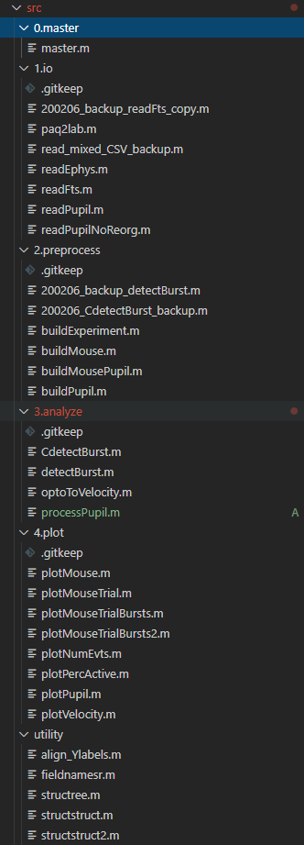
Transitioning to Object Oriented Programing
One trial
Class Object
Related Trials
Experimental Comparison
Functions
(i/o)
Data
Parameters

Slide 15
Control
Trial
Control
Trial
Control
Trial
Exp
Trial
Exp
Trial
Exp
Trial
All Control Trials
All Exp Trials
Figures and Plots
Figures and Plots
Experimental Comparison
Analysis / Comparison Results
Figures and Plots

Slide 16
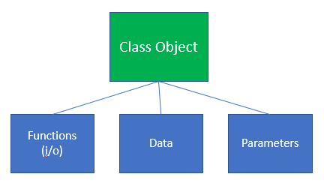
Properties
Processing/Analysis Methods
Plotting Methods
Transitioning to Object Oriented Programing
One trial
Related Trials
Experimental Comparison

Slide 17
Properties
Processing/Analysis Methods
Plotting Methods
Transitioning to Object Oriented Programing
One trial
AQuA_results
Velocity
Pupil
LFP
…
LowPassFilter()
RemoveOutliers()
ProcessPupil()
…
plotPercActive()
plotNumEvents()
plotLocomotion()
plotPupil()
plotSpectrogram()
plotSpectrum()
…
plotC(‘Spectrogram’, ‘Locomotion’)
plotTrial
Related Trials
Experimental Comparison

Slide 18
Properties
Processing/Analysis Methods
Plotting Methods
Transitioning to Object Oriented Programing
One trial
AQuA output
Velocity
Pupil
LFP
…
LowPassFilter()
RemoveOutliers()
ProcessPupil()
…
plotPercActive()
plotNumEvents()
plotLocomotion()
plotPupil()
plotSpectrogram()
plotSpectrum()
…
plotC(‘Spectrogram’, ‘Locomotion’)
plotTrial
Related Trials
areasMean
areasSEM
durationMean
durationSEM
spectrumMean
spectrumSEM
…
multiLowPassFilter()
multiRemoveOutliers()
multiProcessPupil()
…
plotAquaMeans
plotSpectrumMean
…
plotCTrials(‘PercAvtive’,
‘Pupil’,
‘Locomotion’)
plotTrials
Experimental Comparison

Slide 19
Properties
Processing/Analysis Methods
Plotting Methods
Transitioning to Object Oriented Programing
One trial
AQuA output
Velocity
Pupil
LFP
…
LowPassFilter()
RemoveOutliers()
ProcessPupil()
…
plotPercActive()
plotNumEvents()
plotLocomotion()
plotPupil()
plotSpectrogram()
plotSpectrum()
…
plotC(‘Spectrogram’, ‘Locomotion’)
plotTrial
Related Trials
areasMean
areasSEM
durationMean
durationSEM
spectrumMean
spectrumSEM
…
multiLowPassFilter()
multiRemoveOutliers()
multiProcessPupil()
…
plotAquaMeans
plotSpectrumMean
…
plotCTrials(‘PercAvtive’,
‘Pupil’,
‘Locomotion’)
plotTrials
Experimental Comparison
[All above properties for each cohort and individual trial]
…
treatedVSuntreated()
…
plotComparisons()
…

Slide 20
AQuA
Ephys
Pupil
Locomotion

Slide 21
AQuA
Ephys
Pupil
Locomotion

Slide 22
Extracting salient information
One trial:
Data structure is >700 MB

Slide 23
Extracting salient information
One trial:
Data structure is >700 MB

Slide 24
Generally:
Have default parameters file or copy and modify parameters file as needed per experiment
Build an experiment class object:
buildExperiment(experiment_parameters)
3) Plot results and run comparison analysis

Slide 25
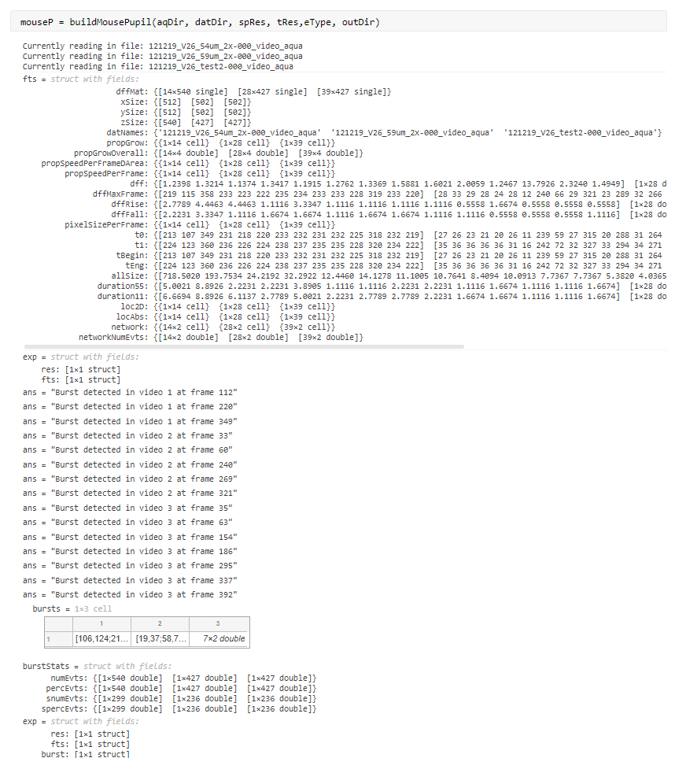
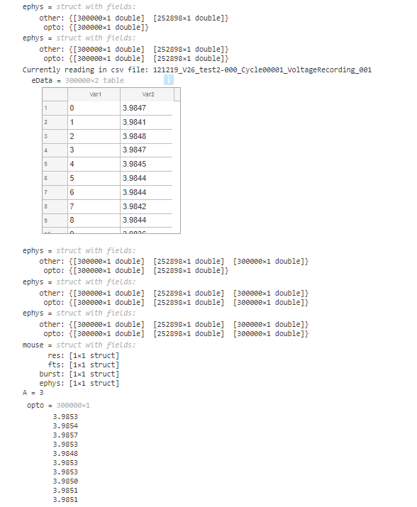
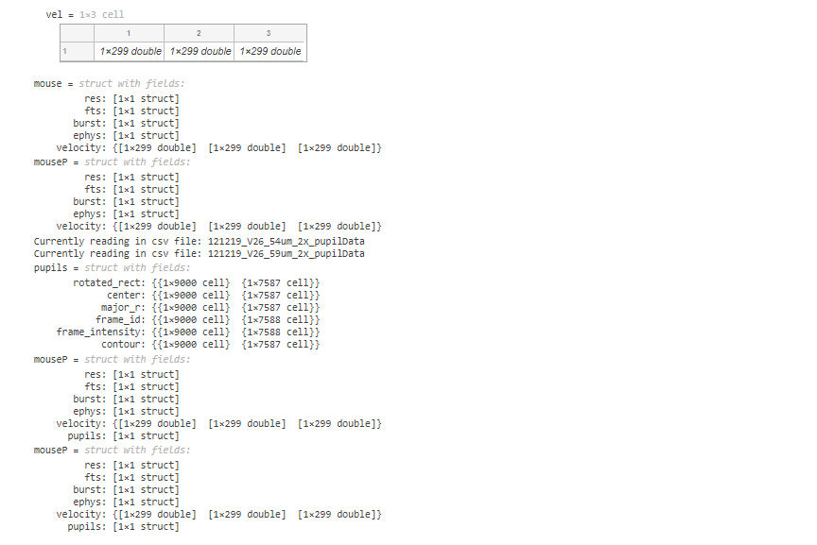

Slide 26
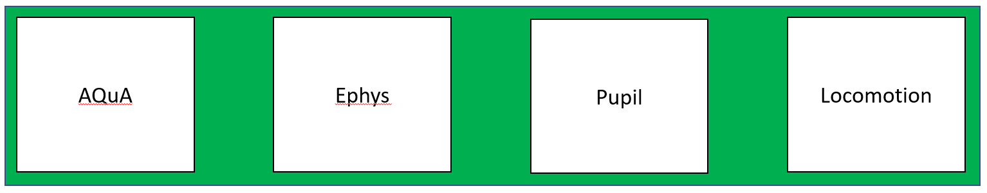
Extracting salient information
T = ~35s
Preprocess
Functions:
readFts
readEphys
readPupil
detectBursts
detectSparkles
opto2velocity
…
One trial:
Data structure is >700 MB
Three trials
Data structure is ~3 MB

Slide 27
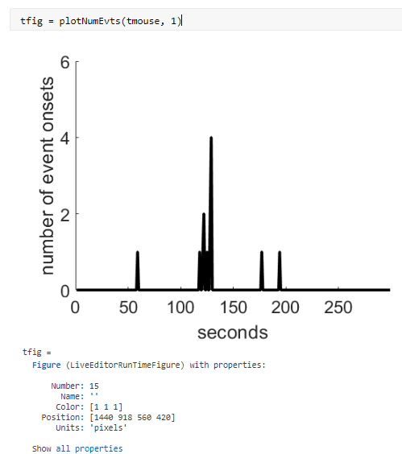
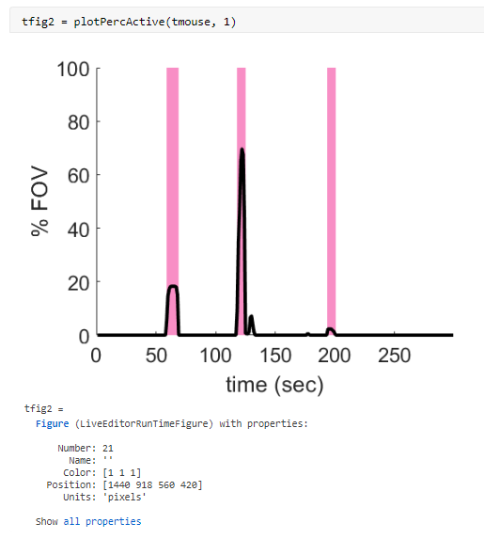

Slide 28
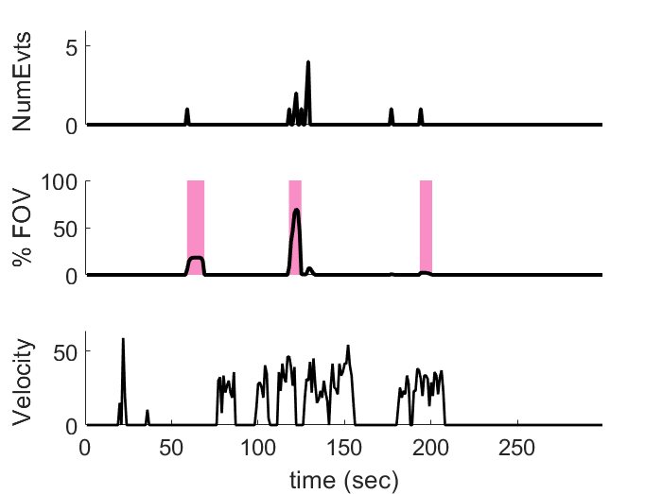
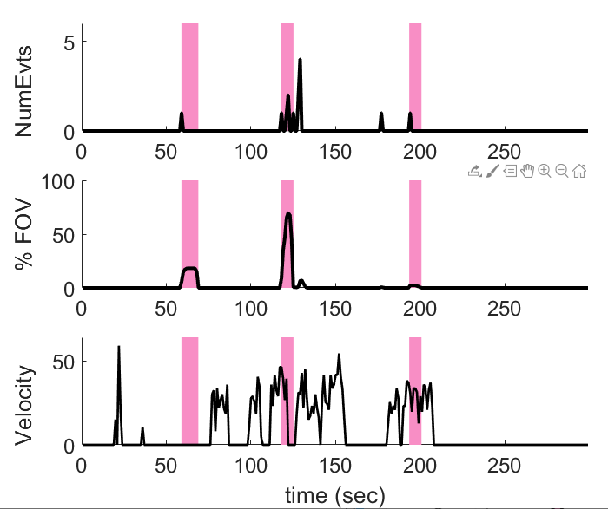
plotMouseTrial(v26, 1 )
/or/
v26.plotMouseTrial(1)
plotMouseTrialBursts(v26, 1)

Slide 29
Generally:
Have default parameters file or copy and modify parameters file as needed per experiment
Build an experiment class object:
buildExperiment(experiment_parameters)
3) Plot results and run comparison analysis

Slide 30
